Slide 1

Walmart Super Store sales Data Analysis

Slide 2
Transform data
Format or Change data type or Transform of raw data.
If needed add Helper column or new column to calculate functions.
Import data
Use import option to import raw data excel into PowerBI
Load & Transform data
Save and close the raw data excel.
Confirm the all column's datatypes are updated appropriately ( Ex. Date-Date format, Numbers – Number format, Amount - Accounting format/Currency format.
PowerBI
Good to Start create an interactive dashboard based on requirement.

Slide 3
Problem Statement
The Walmart Superstore wants to analyze its sales data to gain insights into its performance and identify opportunities for growth. The company has a vast amount of sales data, including information on products, customers, stores, and transactions. The main objective is to extract meaningful insights from this data to analyse the overall sales of walmart superstore.
Analyzed the sales data in multiple angles and understand how the sales is went through region wise, Product wise, Discount wise and etc.,
PowerBi Report is helps to given a solution to improve the business and if incase any mistakes or wrong moves or crossed that is also identified.

Slide 4
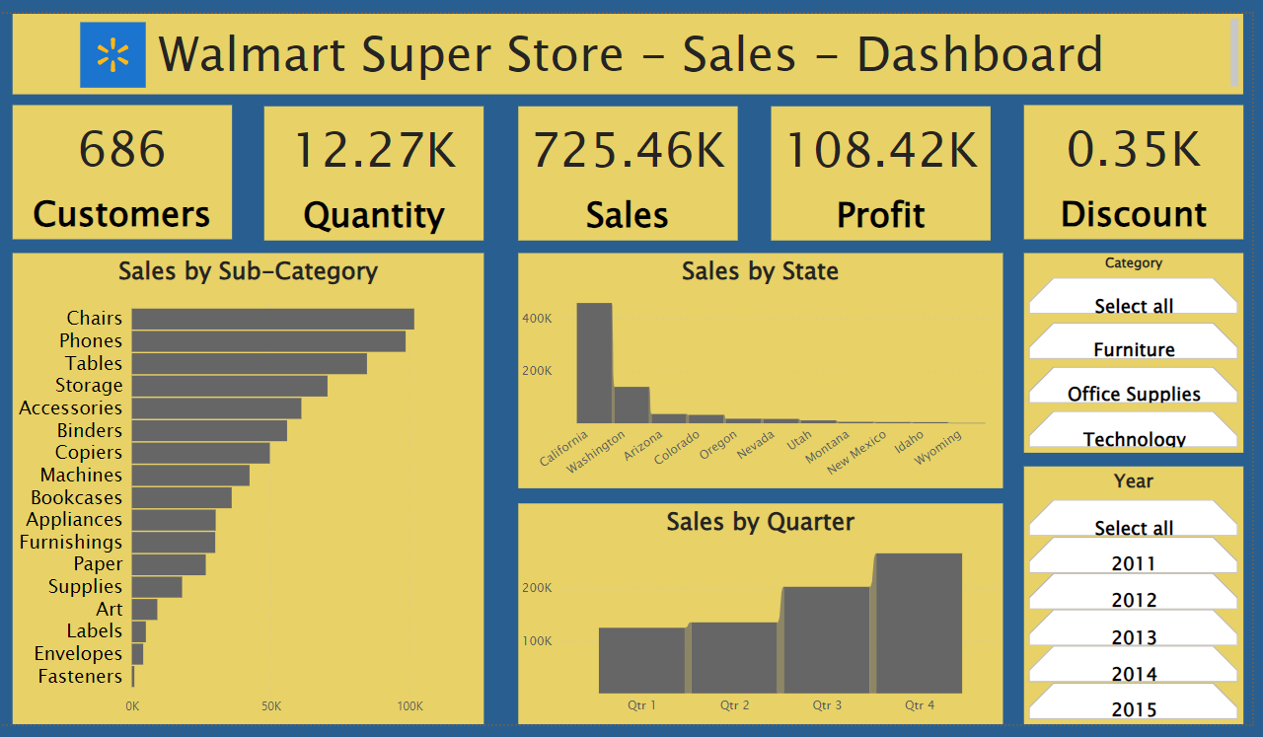
I Have Prepared the below dashboard in Powerbi using the Sales data from Walmart superstore

Slide 5
My Solutions
Start marketing for small number of quantity sold states.
Promoting Offers and targeting to add new customers.
Start selling for Compo offer methodology to improve quantity of sales.
Keep maintaining existing customers providing by exclusive offers to them.

